Slide 1
Accessibility in ios8 Sarah Stargardt November 14, 2014
Vision Accessibility Features

Slide 2
Text Size & text effects

Slide 3
Smaller changes
Settings > Display & Brightness > Text Size > drag the slider
This exhibits smaller changes to the text size
Can change the brightness for kids who experience light sensitivity

Slide 4
Larger text
General > Accessibility > Larger Text
Toggle “Large Accessibility Sizes” on
Drag the slider to preferred size
Text will change in:
Notes
Mail
iMessage
Contacts
Reminders
Does not increase text size in Settings menus

Slide 5
Grayscale
General > Accessibility > Grayscale
Turns all of the content on your device grey
Can be combined with Invert Colors or Zoom to assist the low-vision user in any number of ways
Good for students with Achromatopsia

Slide 6
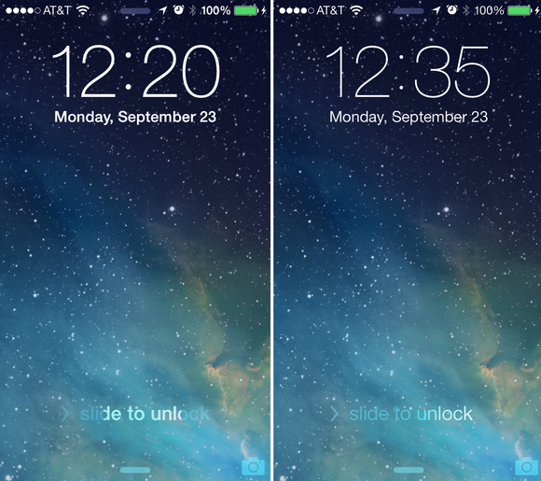
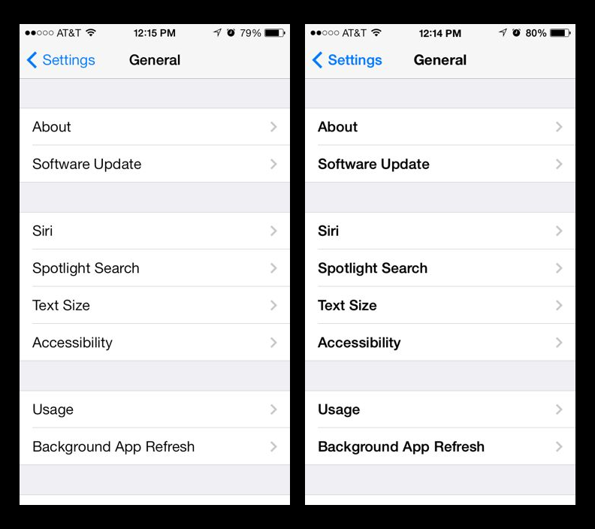
Bold Text
General > Accessibility > Bold Text
Width of letters will change automatically
Fonts become darker
Turning this on re-starts your iPad

Slide 7
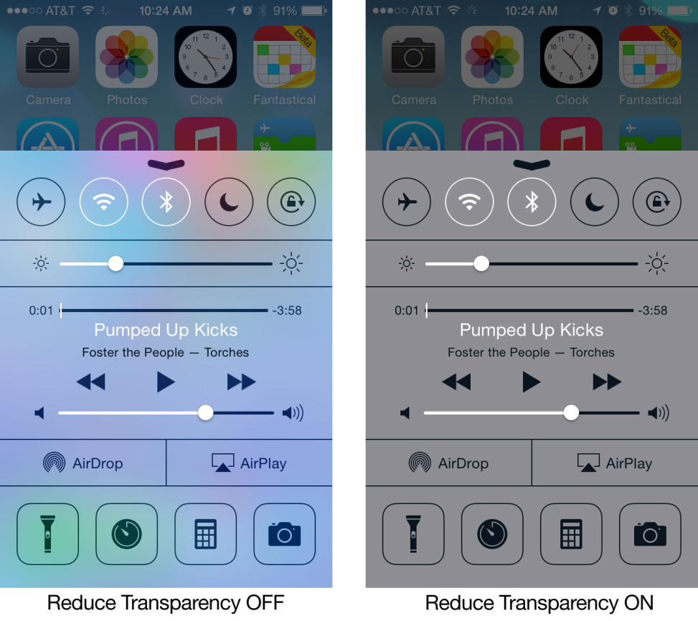
Increase contrast
General > Accessibility > Increase Contrast
Reduce Transparency
Improves contrast on some backgrounds to increase legibility

Slide 8
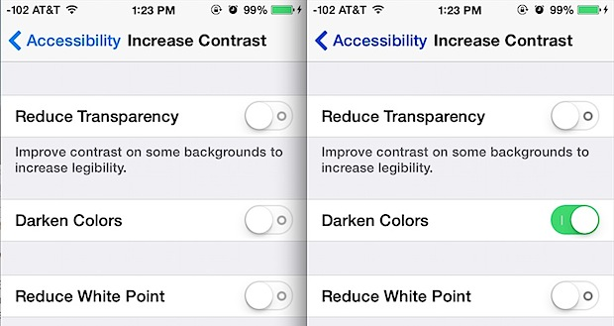
Darken colors
The same Settings panel you’re at will demonstrate the difference when darken colors is on or off, though it’s surprisingly subtle. Can you see the color difference in these two pictures side-by-side?
Look at the blue text and arrow for “< Accessibility", and look at the tiny grey circles within the switches. Again, it's quite subtle, but it does help if you've thought the light blue text was hard to read

Slide 9
Reduce white point
Reduces the intensity of bright colors

Slide 10
Reader view
Removes clutter from websites to make them reader-friendly
If reader view is available, safari now shows “reader view available” in the address bar
Tap the three horizontal lines on the left side of the address bar to activate it
Once activated you can increase or decrease font size (iOS8)
Tap the big and small A buttons at the top of the page
Some websites with Reader View:
Nfb.org
En.m.wikipedia.org
Applevis.com

Slide 11
Zoom
General>
Accessibility > Zoom

Slide 12
Standard zoom
Magnifies the entire screen
Think “3 Fingers”!!
Double-tap three fingers to zoom
Drag three fingers to move around the screen
Double-tap three fingers and drag to change zoom
Maximum zoom can be changed from 1.25x - 15x

Slide 13
New Zoom features
Show Controller
Places a joystick on screen:
Follow Focus
Determines whether or not the Zoom lens will follow the text cursor
Zoom Region
Allows a user to use Window Zoom (smaller than full-screen lens) or Fullscreen (as in previous version of iOS)
Maximum Zoom Level
This slider allows users to limit how much magnification Zoom will offer, which is helpful on iPod & iPhone due to screen size limitations

Slide 14
Show controller
New Controller!
Zoom > Show Controller
The controller is a great feature that simplifies using Zoom by providing:
Easy access to change Zoom and filter settings. When users press the controller, it opens up the Zoom and filter options.
The ability to change the magnification without having to use a three finger gesture. Within the controller options is a magnification slide bar users can use to zoom in and out of either the full screen or lens.
The ability to navigate around the screen with a virtual joystick. The controller itself becomes a virtual joystick when users press and hold the controller and move up, down, left, or right to navigate around the screen.
The choice to not use the controller. You can still use Zoom the old fashioned way!
Can move the zoom controller around when zoomed out
Can change the contrast of the controller
Zoom > Idle Visibility > Move Slider

Slide 15
Follow focus
Setting that determines whether or not the zoom lens will follow the text cursor. This helps users stay oriented on the page while typing.
Zoom Keyboard: In full screen zoom, keeps the content zoomed while the keyboard stays the same size while typing.

Slide 16
Applying zoom’s features
Using Windowed Zoom
When a lens is enabled, a user will se a small horizontal bar at the bottom of the lens which allows access to controls and allows user to move the lens itself
Drag the control to move the lens
Single tap the control circle to open an on-the-fly Zoom control panel
Zoom in or out
Choose between fullscreen or window zoom
Resize the zoom lens
Filter just the zoom lens
Inverted
Grayscale
Inverted grayscale
Low light (which dims the lens on screen only
Hide or show controller
Grow or shrink magnification size

Slide 17
Glitches
Zoom and VoiceOver do now work well together
Voiceover takes over when they are enabled at the same time
Zoom seems to revert to it’s old structure (full screen zoom or none) when they are on at the same time

Slide 18
speech

Slide 19
Speak screen
Settings > General > accessibility > Speech > Speak Screen
Swipe down with 2 fingers from the top of the screen to hear the content of the screen
Simple way for low-vision users to “read” the screen only
Only gives users access to rewind, fast forward, play/pause, and speed (not intended to be a replacement for VoiceOver)
Simple solution when a low-vision user would like to quickly read an entire screen

Slide 20
Speak selection
Settings > General > Accessibility > Speak Selection
When you highlight a section of text, menu bubble appears, select “Speak”

Slide 21
Hey siri
Settings > General > Siri > Allow “Hey Siri”
Can activate Siri by saying “hey Siri”
Drains battery, so only works if you are plugged into a power source

Slide 22
Video descriptions
Settings > General > Accessibility > Video Descriptions (under Media heading)
When available, automatically plays video descriptions
Hopefully iTunes will start selling content that has video descriptions in the near future

Slide 23
Voiceover

Slide 24
overview
VoiceOver is the screen-reader that announces what appears on the screen. This allows a person who is blind and visually impaired the ability to access the iPad.
When you select an element/item on the iPad, a black rectangle called the “VoiceOver Cursor” encircles it and VoiceOver speaks the name or describes the item.

Slide 25
Turn on “VoiceOver” by going to Settings > General > Accessibility > VoiceOver, toggle the “off” button to “on”
Speak Hints: On
Speaking Rate: 1/3 of the way
VoiceOver speaks items on the screen
Drag finger across screen to hear items (do this with icons)
To select an item, touch it
To activate the selected item, double-tap anywhere on the screen
To scroll, flick 3 fingers (if there is more than 1 page)

Slide 26
miscellaneous

Slide 27
Accessibility shortcut
Shortcut
General > accessibility > Accessibility Shortcut
Select the options you use regularly
You can now press the home button 3x quickly to toggle off/on

Slide 28
Join.me

