Slide 1
I’m a Bookshare Sponsor: Now What Do I Do?
Ronnie Connors and Kathi Tarrant-Parks
Notes:
Introductions.
What do you hope to learn from this session?

Slide 2
How Familiar Are You With Bookshare?
Which best describes you?
Little familiarity with Bookshare
Some familiarity with Bookshare
Very familiar with Bookshare
Notes:
KATHI
Using a show of hands, participants will indicate their level of familiarity with Bookshare.

Slide 3
What is Bookshare?
Bookshare is an accessible online library for students with print disabilities.
Bookshare books are “accessible,” which means you can read the books many different ways.
309,228 titles and counting!
Bookshare membership is free to all U.S. K-12 students.
Notes:
KATHI
to provide a brief overview of Bookshare.

Slide 4
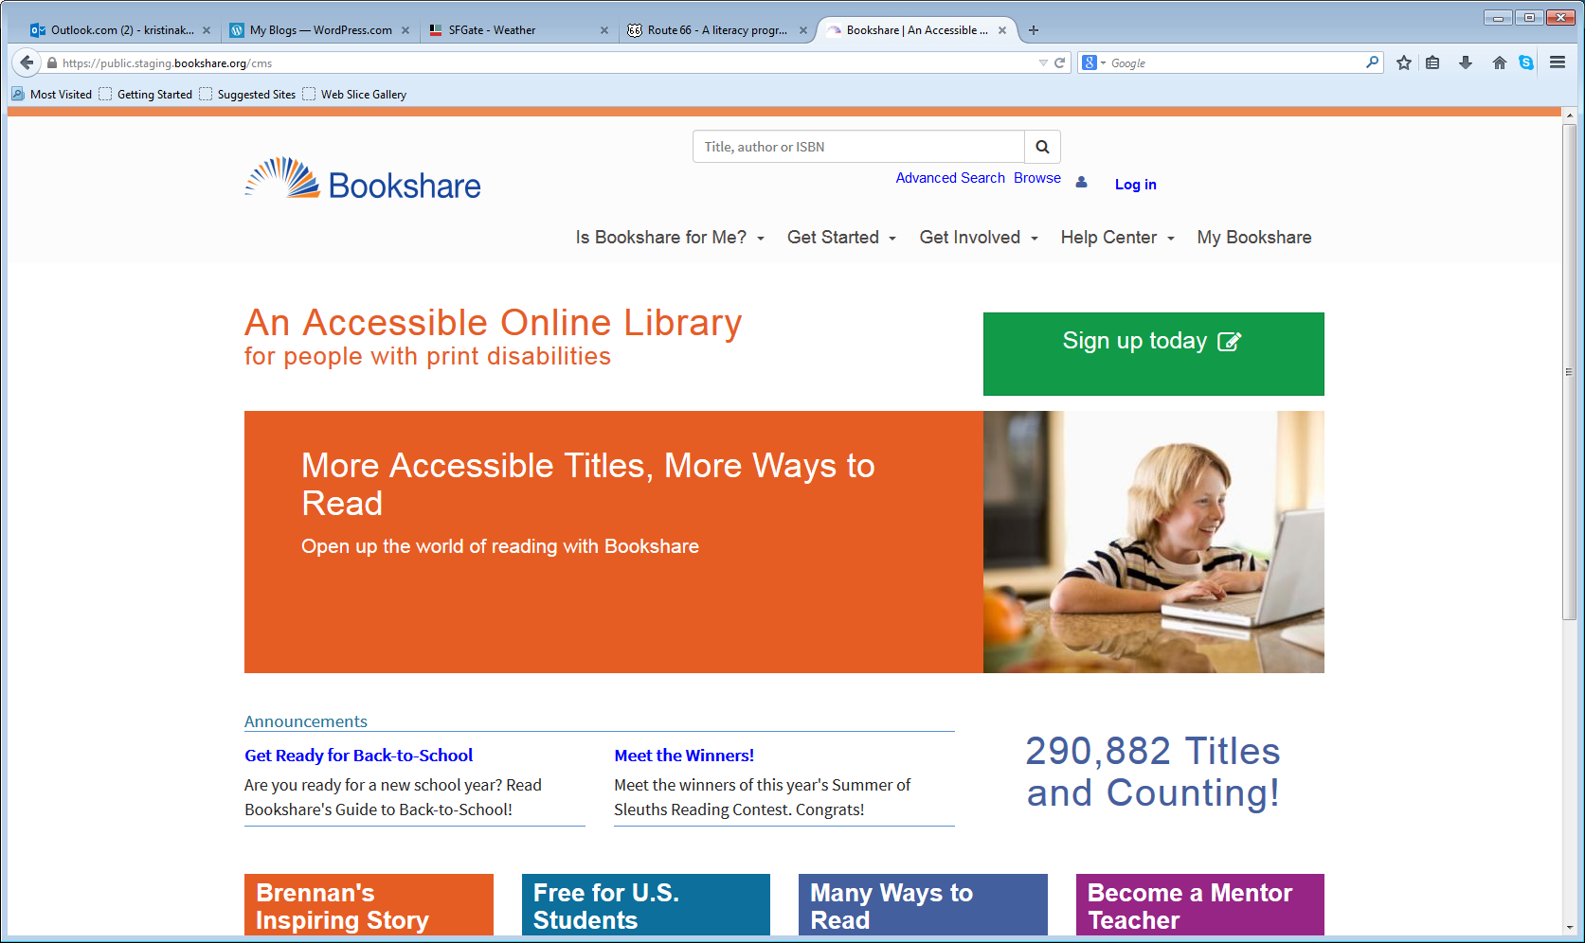
A new, more user-friendly Bookshare website…
Notes:
KATHI
New site launched last month. Better and easier access to information.
How does this impact members? Not much!
The two main changes are the “My Bookshare” section (formerly the member’s Task Bar) and the “Help Center” (formerly the Support Portal)
No changes to how you sign up, find/request books, download books, and manage accounts. Screen reader users will notice a slight change to where the Log in button is located on the homepage.
Site is better optimized for viewing on mobile devices. Bookshare reading tools remain unchanged.

Slide 5
My Bookshare
Notes:
(Image of My Bookshare hub page)
KATHI My Bookshare is the new personalized page for members (previously the member’s “Task Bar”)
Current members log in in the upper right hand corner, and provide their Bookshare email address and password in the text edit boxes.
After you log in, select the “My Bookshare” link. Here you can:
• Manage your account
• Change Your Password
• Update Account Preferences
• Display Your Book History
• Access Reading Lists
• Download Reading Tools
• Add Or Update Members And Sponsors
• Upload Roster
• Manage Reading Lists
• View Download History

Slide 6
Help Center
Notes:
(Image of Help Center hub page)
KATHI The Help Center replaces the Support Portal.
What you will find on the Help Center hub page:
Using Bookshare (including information on our various reading tools options)
Managing Account
Learn More About Bookshare (including more about how to find and request books)
Resolve Issues
Contact Us
Link to Training And Resources

Slide 7
Bookshare Academy The New Home for Training Resources
Online Courses for professional credit
Videos and webinars
Tools for Trainers, including:
Train-the-Trainer resources
Mentor Teacher resources
Parent Ambassador resources
Pre-Service Teacher resources
Other Resources from partner organizations
Notes:
KATHI In the new Training and Resources section you will find Bookshare Academy!
Bookshare Academy contains a wealth of Bookshare, AEM and AT training and resources.
You will find:
Online Courses for professional credit
Videos and webinars
Tools for Trainers, including:
Train-the-Trainer resources
Mentor Teacher resources
Parent Ambassador resources
Pre-Service Teacher resources
Other Resources from partner organizations

Slide 8
Parent Ambassadors
A new resource for Bookshare parents interested in helping other parents get involved and to stay informed.
Access information, training, and a network of parents.
Sign up: http://communications.bookshare.org/parent-ambassador-program/
Notes:
KATHI Discuss this new resource for parents

Slide 9
Roles in an Organizational Membership
Point of Contact
Sponsor
Member
Responsibilities: organizational account oversight, communication with Bookshare, adding at least one Sponsor.
Responsibilities: Add and manage Members. Download Books for Members.
Responsibilities: Read Bookshare Books using multiple methods.
Notes:
RONNIE The nitty gritty of being a sponsor…
Discuss flowchart
Responsibility of Primary contact – add a sponsor – MAKE SURE you let sponsor know you added them, because email bookshare sends them may go into their spam.
Sponsor adds members
Ask questions: Who has an organization, PC, Sponsors, Members
Add member on demo org
When at disability part, talk about who qualifies

Slide 10
What is Your Bookshare Status?
Does your school have an organizational account?
If so, have you been added as a Sponsor?
If so, have you added a Member (student) and have you downloaded books for members?
If so, have you delivered books to the students?
Notes:
RONNIE

Slide 11
Adding a Member
Notes:
RONNIE…login to Bookshare Org Demo account and add a member… Add member to Quicklist (roster)
When we get to the qualifying disability, “So, how do we know who qualifies for free Bookshare membership?

Slide 12
What is a Print Disability?
A print disability is a physically-based disability that makes it very difficult or impossible to read standard print.
These include:
blindness or low vision,
a physical disability in which an individual cannot hold a book or turn the pages of a book, or
A documented learning or reading disability
Notes:
RONNIE A print disability is a physically-based disability that makes it very difficult or impossible to read standard print.
These include:
blindness or low vision,
a physical disability in which an individual cannot hold a book or turn the pages of a book, or
a documented learning or reading disability

Slide 13
Eligible Students
Record of disability kept at school!
Disability | Qualified/Not Qualified | Examples of Competent Authorities
Visual Impairment (VI) Blindness / Low vision | Qualified, if confirmed by a listed Competent Authority | A family doctor or other medical professional, physical therapist, resource specialist, Special Education teacher
Physical Disability (PD) | Qualified, if confirmed by a listed Competent Authority that the disability significantly affects the use of printed materials
Learning Disability (LD) Reading Disability | Qualified, if confirmed by a listed Competent Authority, that the disability has a physical basis and significantly affects the use of print
Autism Emotional disabilities ADHD |  | Examples listed above
ESL and ELL
A family doctor, ophthalmologist, optometrist, Teacher of the Visually Impaired, Special Education teacher; Certification from the National Library Service for the Blind and Physically Handicapped in the U.S. or similar national body in other countries
A neurologist, psychiatrist, learning disability specialist, Special Education teacher, school psychologist, or clinical psychologist with a background in learning disabilities
Not qualified under this diagnosis, unless accompanied by a qualifying visual, physical, learning or reading disability as certified by a Competent Authority as above
Notes:
13
RONNIE This is a table that clarifies eligibility.
Now, let’s go back to the member we are adding…
Only blind or other persons with disabilities that affect their ability to access print are permitted to download copyrighted books. A print disability is a physically-based disability that makes it very difficult or impossible to read standard print. These include blindness or low vision, a physical disability in which an individual cannot hold a book or turn the pages of a book, or a severe learning disability, such as severe dyslexia, that affects reading. The disability must be a physically-based disability that makes it very difficult or impossible to read standard print.
Bookshare operates under the Copyright Act As Amended (“Chafee Amendment”) and determines eligibility based on the Chafee Amendment rather than the definitions of disability in education law (IDEA).
It is up to the certifying professional who knows and is working with the student to make the decision regarding eligibility. If the student has documentation from a qualified professional that states that he or she has a print disability that requires print materials in alternate formats, then that student qualifies for Bookshare. A certifying professional can be any professional with credentials in the specific disability being assessed, such as a qualified professional in the field of disabilities services, education, medicine, or psychology.
Bookshare’s process:
Bookshare follows the procedures and standards for access to books that were developed by Recording for the Blind and Dyslexic (RFB&D). A Bookshare user must register and supply a signed certification completed by an appropriate professional in the field of disability services education, medicine, psychology or a related area. The certifier must be a recognized expert who can attest to the physical basis that limits the applicant's use of standard print. Appropriate certifying experts may differ from disability to disability. For example, in the case of blindness and visual impairments, an appropriate certifier may be a physician, ophthalmologist, or optometrist. In the case of a perceptual disability, a neurologist, learning disability specialist, or a psychologist with a background in learning disabilities may be the most qualified certifying professional.
In addition, since any U.S. resident who has previously submitted a proof of disability to NLS (National Library Service for the Blind and Physically Handicapped of the Library of Congress) would qualify under the law, we have a cooperative agreement where NLS will certify to us that he or she has such proof already.

Slide 14
Value-Add Option for Members Individual Membership
Benefits:
Students can take school work home and study
Install free reading tools on home computer
Download own books, including fun, leisure books
Build reading skills and independence year-round
Can easily transition to postsecondary education and adulthood
Easy to sign-up or connect an existing membership.
FREE for all students who qualify at school, sign them up today!
14
Notes:
KATHI
These are some of the benefits of helping students access Bookshare at home – ready anytime anywhere! We’ll cover ‘how’ easy it is for a teacher to facilitate!
Before moving on, I’d like to point out that for those students who do not have access to the internet at home, they can still download books and reading tools to a CD, thumb drive, other accessories that they CAN take home.
14

Slide 15
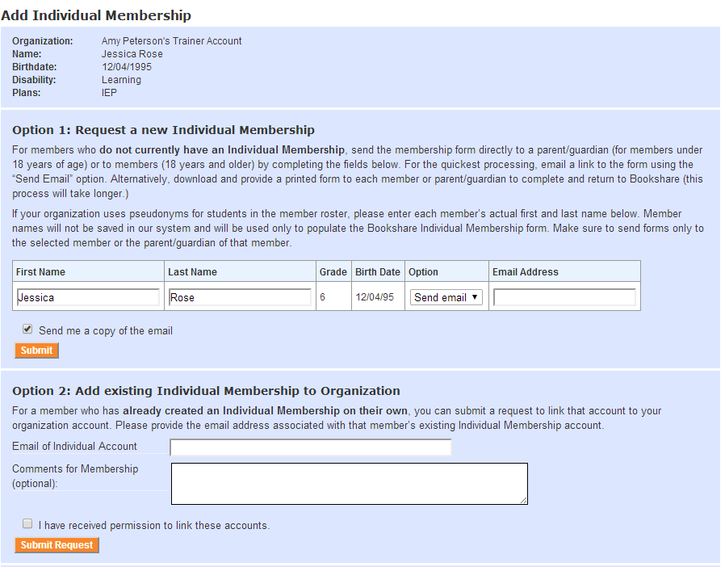
Encouraging Individual Memberships Teachers Can Make the Process Easy!
Option 1: Request New Individual Membership
Student doesn’t already have membership
Add student actual name if school uses pseudonyms
Select e-mail (family’s e-mail address) or download form
Proof of disability already on file
Option 2: Add Existing Individual Membership
Student already has individual membership
Need to know associated email address
Notes:
KATHI
You can help your students get Individual memberships with an easy process. Students who have individual memberships (with their own passwords) can download books for themselves. To qualify for a free membership, the student must include the school’s name on the Membership Agreement Form.
If the student is already a member of your organizational membership, you can print a special form that will allow the student to register without sending additional proof of disability. Go to My Organization, select the “Members” option, select a student on your roster and select the “Individual Membership Form” button. You’ll be asked to download a PDF form. This form contains a special code that will allow Bookshare to approve disability based on the student’s organizational membership details. Have the student or parent fill out the remaining fields on the form and return it to Bookshare by mail or fax.
Trainers should also make sure to remind teachers that they should inform students and parents of Bookshare rules and future trainings.
Teachers will have access to the “Bookshare letter for parents” on the Bookshare.org website in the ‘training page’ where they can also find the Bookshare quick guides.
Steps:
Easily Print Pre-filled Individual Membership Forms
Login to Bookshare
Select “My Organization” from task bar
Select “Members”
Select check box by name of each student
Select “Individual Membership Form” at bottom
Save and print forms for all students
Download and print “Send Home Membership Letter for Parents” on Bookshare Training page
Send home both forms with your students for parents to read, sign, and send to Bookshare

Slide 16
Let’s take a more in-depth look…
Notes:
RONNIE…login to Bookshare and go through the process of searching, downloading, assigning a book to member…

Slide 17
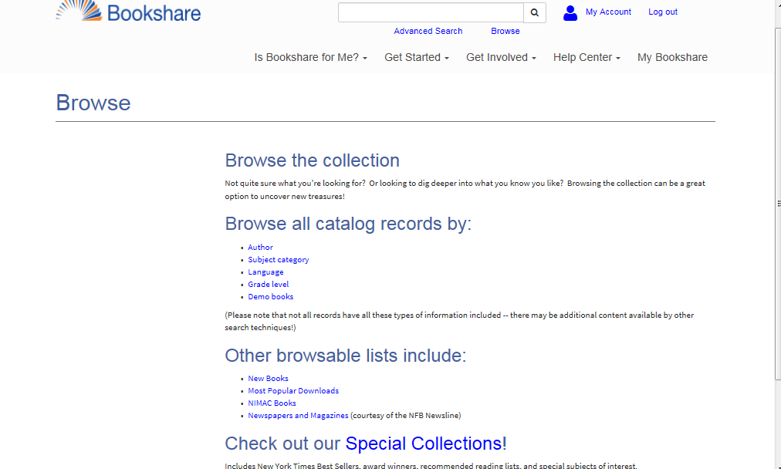
Search and Browse Books
Standard Search
by
‘Title or Author’
Browse by….
Author
Category
Language
New Books
Most Popular Downloads
NIMAC Books
Special Collections
Newspapers / Magazines
Internationally Available
Grade
Publisher
Notes:
RONNIE
Go to Bookshare and talk about search
Actually search and locate Huckleberry Finn
First, check members- then “download”
Second, locate another book and click “add to reading list”

Slide 18
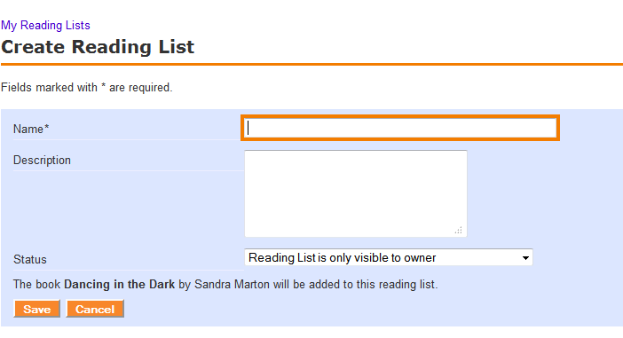
Creating a Reading List
Notes:
RONNIE

Slide 19
Sharing a Reading List with a Student
Click on Add Members
Check whether they have an organizational and individual membership account
Select the student you want to share with
Notes:
RONNIE

Slide 20
Downloading Books – It’s Easy!
Download software
Victor Reader Soft
Read:OutLoud, Windows and Macintosh
Browse extensive library
Use search features
Find book, select (organizational) Member
Download Book
Extract files and save to appropriate folder
Student can open and read book with assistive reading tool
Notes:
20
These are the high-level steps you’d take to download a book from Bookshare’s extensive library. Now, lets take a closer look at each of these steps.
If you want to distribute the same book to multiple students, you’ll need to download a separate copy of the book for each student. During the downloading process, you’ll have the option to select multiple Member names. At the finish page, you will see a separate book file for each Member you selected, marked with that Member’s first and last name. Select each file to begin the download process. Ultimately, downloading files one by one will be faster for you, because file size would increase if multiple student books were in one zipped download. Also, you can distribute the smaller zipped files individually to each student. Please be sure each file goes to the right student, in keeping within Bookshare's digital rights management policy.
Bookshare books can be copied to other media (e.g., CD, flash drive, school district network drive – password protected on school networks) for the purposes of transferring the book to the qualified Member selected when the book is downloaded. While the media containing the books may change, books must stay in the possession of the qualified Member.
Bookshare books cannot be handed over to someone other than the student for whom it was downloaded. Following is an excerpt from the Organizational Agreement that covers this concept: Each time I download a book from Bookshare, I will select the Member for whom I am downloading the Accessible Media. I will decrypt the Accessible Media using my password and deliver it only to the Member for whom I downloaded that particular Accessible Media. I agree that once I have delivered the book to that Member, I will delete the copy I downloaded.
Saving Books with Internet Explorer
Internet Explorer asks you for a location each time you download a file, so you can choose where you want to store your books. Bookshare recommends that you create a folder just for books and always save books to that folder.
Saving Books with Mozilla Firefox
With Firefox the default location for downloaded files depends on the operating system:
Windows XP saves downloaded files to the Desktop.
Windows Vista saves downloaded files in a Downloads folder in your user folder (e.g. Joe Smith > Downloads).
To change the download settings in Firefox, go to the Tools menu and choose Options. You can specify a different download location or you can have Firefox ask you for a location each time you download a file.
Saving books with Safari on a Macintosh
Safari saves downloaded files to the Downloads folder in your user folder. Once you download a Bookshare “.zip” book file, you will then need to open and save the file using Unarchiver or Stuffit so you can read the book using your Safari browser.
When you install Unarchiver or Stuffit, you are asked where you want to save “unzipped” files.
Use a common list of novels to search during this lab. (Have participants notice the differences between download procedures for copyrighted vs. out of copyright books.)

Slide 21
Bookshare Reading Options
Computer
Download free software and books to a computer; read
AT Devices
Download books (in DAISY Text, DAISY with Images, DAISY Audio, or BRF formats) to computer, transfer to AT devices; or download directly to devices.
Mobile
Read2Go: Download, read on iOS devices
Web
Bookshare Web Reader: Read in an Internet browser!
Go Read: Download, read on Android devices
Download MP3 format for MP3 players
Notes:
KATHI
Not enough just to have the book in a digital format… we need something to read the books…
Bookshare also offers several ways to access Bookshare books…
The key is figuring out what technology works best for your student and equipping them with the tools they need to be successful.

Slide 22
Let’s Practice….
Launch Bookshare using: www.bookshare.org
Login to Bookshare using the following:
Member: orgdemo@bookshare.org
Password: demo480
Notes:
RONNIE
Provide time for participants to login to the Bookshare Demo account….
Search and browse
Download the book.

Slide 23
Thank you!

